Slide 1

18CSC305J
ARTIFICIAL INTELLIGENCE
UNIT – 1
CLR1 : Provide a broad understanding of the basic techniques for building intelligent computer systems and an understanding of
how AI is applied to problems.
CLO1 : Formulate a problem and build intelligent agents

Slide 2
Unit 1 List of Topics
Adversarial Search Methods (Game Theory) - Mini max algorithm - Alpha beta pruning - Constraint satisfactory problems – Constraints – Crypt Arithmetic Puzzles – Constraint Domain – CSP as a search problem (Room colouring). Intelligent Agent – Rationality and Rational Agent – Performance Measures – Rationality and Performance – Flexibility and Intelligent Agents – Task environment and its properties – Types of agents

Slide 3
Definition of adversarial search
Searches in which two or more players with conflicting goals are trying to explore the same search space for the solution, are called adversarial searches, often known as Games.
Games are modeled as a Search problem and heuristic evaluation function, and these are the two main factors which help to model and solve games in AI
What Kinds of Games?
Sequence of moves to play
Rules that specify possible moves
Rules that specify a payment for each move
Objective is to maximize your payment

Slide 4
Games as Adversarial Search
States:
board configurations
Initial state:
the board position and which player will move
Successor function:
returns list of (move, state) pairs, each indicating a legal move and the resulting state
Terminal test:
determines when the game is over
Utility function:
gives a numeric value in terminal states (e.g., -1, 0, +1 for loss, tie, win)

Slide 5
Mini-Max Terminology
move: a move by both players
ply: a half-move
utility function: the function applied to leaf nodes
backed-up value
of a max-position: the value of its largest successor
of a min-position: the value of its smallest successor
minimax procedure: search down several levels; at the bottom level apply the utility function, back-up values all the way up to the root node, and that node selects the move.

Slide 6
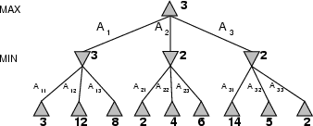
Mini-Max Terminology
Perfect play for deterministic games
Idea: choose move to position with highest minimax value
= best achievable payoff against best play
E.g., 2-ply game

Slide 7
80 30 25 35
55
20 05 65
40 10 70 15
50 45 60 75
11

Slide 8
80
30
25
35
55
20
05
65
40
10
70
15
50
45
60
75
12

Slide 9
80
80
30
25
35
55
20
05
65
40
10
70
15
50
45
60
75
13

Slide 10
30
80
30
25
35
55
20
05
65
40
10
70
15
50
45
60
75
14

Slide 11
30
30
80
30
25
35
55
20
05
65
40
10
70
15
50
45
60
75
15

Slide 12
30
30
25
80
30
25
35
55
20
05
65
40
10
70
15
50
45
60
75
16

Slide 13
30
30
25
80
30
25
35
55
20
05
65
40
10
70
15
50
45
60
75
17

Slide 14
30
30
30
25
80
30
25
35
55
20
05
65
40
10
70
15
50
45
60
75
18

Slide 15
30
30
30
25
80
30
25
35
55
20
05
65
40
10
70
15
50
45
60
75
19

Slide 16
30
30
20
30
25
20
80
30
25
35
55
20
05
65
40
10
70
15
50
45
60
75
20

Slide 17
30
30
20
30
25
20
05
80
30
25
35
55
20
05
65
40
10
70
15
50
45
60
75
21

Slide 18
30
30
20
30
25
20
05
80
30
25
35
55
20
05
65
40
10
70
15
50
45
60
75
22

Slide 19
30
30
20
30
25
20
05
80
30
25
35
55
20
05
65
40
10
70
15
50
45
60
75
23

Slide 20
20
20
30
20
30
25
20
05
80
30
25
35
55
20
05
65
40
10
70
15
50
45
60
75
24

Slide 21
20
20
15
30
20
15
60
30
25
20
05
10
15
45
60
80
30
25
35
55
20
05
65
40
10
70
15
50
45
60
75
25

Slide 22
20
20
15
30
20
15
60
30
25
20
05
10
15
45
60
80
30
25
35
55
20
05
65
40
10
70
15
50
45
60
75
26

Slide 23
20
20
15
30
20
15
60
30
25
20
05
10
15
45
60
80
30
25
35
55
20
05
65
40
10
70
15
50
45
60
75
27

Slide 24
Minimax Strategy
Why do we take the min value every other level of the tree?
These nodes represent the opponent’s choice of move.
The computer assumes that the human will choose that move that is of least value to the computer.

Slide 25
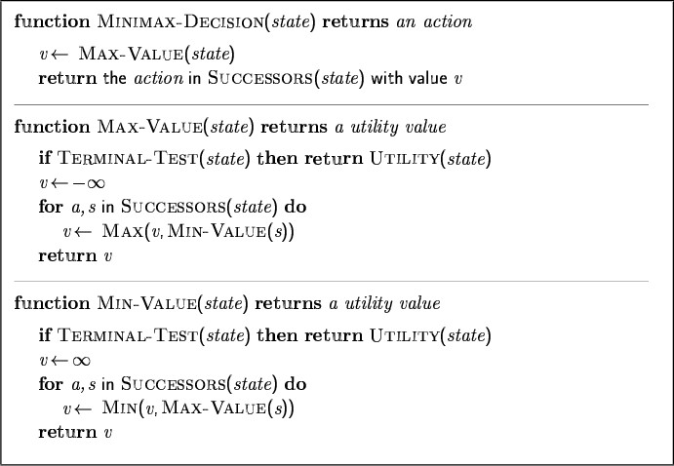
Minimax algorithm Adversarial analogue of DFS

Slide 26
Properties of Minimax
Complete?
Yes (if tree is finite)
Optimal?
Yes (against an optimal opponent)
No (does not exploit opponent weakness against suboptimal opponent)
Time complexity?
O(b^{m})
Space complexity?
O(bm) (depth-first exploration)

Slide 27
Good Enough?
Chess:
branching factor b≈35
game length m≈100
search space b^{m} ≈ 35¹⁰⁰ ≈ 10¹⁵⁴
The Universe:
number of atoms ≈ 10⁷⁸
age ≈ 10¹⁸ seconds
– 10⁸ moves/sec x 10⁷⁸ x 10¹⁸ = 10¹⁰⁴
•
Exact solution completely infeasible

Slide 28
80
30
25
35
55
20
05
65
40
10
70
15
50
45
60
75
32

Slide 29
30
80
30
25
35
55
20
05
65
40
10
70
15
50
45
60
75
33

Slide 30
30
30
25
80
30
25
35
55
20
05
65
40
10
70
15
50
45
60
75
34

Slide 31
30
Do we need to check this node?
30
25
80
30
25
??
55
20
05
65
40
10
70
15
50
45
60
75
35

Slide 32
30
No - this branch is guaranteed to be worse than what max already has
30
25
80 30 25 X??
55
20 05 65
40 10 70 15
50 45 60 75
36

Slide 33
30
30
20
Do we need to check this node?
30
25
20
05
80 30 25 _{X}35
55
20 05 ??
40 10 70 15
50 45 60 75
37

Slide 34
30
30
20
30
25
20
05
80 30 25 X35
20 05 X??
55
40 10 70 15
50 45 60 75
38

Slide 35
Alpha-Beta
The alpha-beta procedure can speed up a depth-first minimax search.
Alpha: a lower bound on the value that a max node may ultimately be assigned
v > α
Beta: an upper bound on the value that a minimizing node may ultimately be assigned
v < β

Slide 36
Alpha-Beta
MinVal(state, alpha, beta){ if (terminal(state))
return utility(state); for (s in children(state)){
child = MaxVal(s,alpha,beta); beta = min(beta,child);
if (alpha>=beta) return child;
}
return best child (min); }
alpha = the highest value for MAX along the path
beta = the lowest value for MIN along the path

Slide 37
Alpha-Beta
MaxVal(state, alpha, beta){ if (terminal(state))
return utility(state); for (s in children(state)){
child = MinVal(s,alpha,beta); alpha = max(alpha,child);
if (alpha>=beta) return child;
}
return best child (max); }
alpha = the highest value for MAX along the path
beta = the lowest value for MIN along the path

Slide 38
α=-∞ β=∞
α - the best value
for max along the path β - the best value
for min along the path
α=-∞
β=∞
α=-∞ β=∞
α=-∞ β=∞
80
30
25
35
55
20
05
65
40
10
70
15
50
45
60
75
42

Slide 39
α=-∞ β=∞
α - the best value
for max along the path β - the best value
for min along the path
α=-∞
β=∞
α=-∞ β=∞
α=-∞ β=80
80
80
30
25
35
55
20
05
65
40
10
70
15
50
45
60
75
43

Slide 40
α=-∞ β=∞
α - the best value
for max along the path β - the best value
for min along the path
α=-∞
β=∞
α=-∞ β=∞
α=-∞ β=30
30
80
30
25
35
55
20
05
65
40
10
70
15
50
45
60
75
44

Slide 41
α=-∞ β=∞
α - the best value
for max along the path β - the best value
for min along the path
α=-∞
β=∞
α=30
β=∞ 30
α=-∞ β=30
30
80
30
25
35
55
20
05
65
40
10
70
15
50
45
60
75
45

Slide 42
α=-∞ β=∞
α - the best value
for max along the path β - the best value
for min along the path
α=-∞
β=∞
α=30
β=∞ 30
α=30
β=∞
α=-∞
β=30 ³⁰
80
30
25
35
55
20
05
65
40
10
70
15
50
45
60
75
46

Slide 43
α=-∞ β=∞
α - the best value
for max along the path β - the best value
for min along the path
α=-∞
β=∞
α=30
β=∞ 30
β ≤ α prune!
α=30 β=25
25
α=-∞
β=30 ³⁰
25 X35
80
30
55
20
05
65
40
10
70
15
50
45
60
7547
7547

Slide 44
α=-∞ β=∞
α - the best value
for max along the path β - the best value
for min along the path
α=-∞ ₃₀
β=30
α=30
β=∞ 30
α=30 β=25
25
α=-∞
β=30 ³⁰
25 X35
80
30
55
20
05
65
40
10
70
15
50
45
60
7548
7548

Slide 45
α=-∞ β=∞
α - the best value
for max along the path β - the best value
for min along the path
α=-∞ ₃₀
β=30
α=30
β=∞ 30
α=-∞ β=30
α=30 β=25
α=-∞
25
α=-∞ β=30
β=30 ³⁰
25 X35
80
30
55
20
05
65
40
10
70
15
50
45
60
7549
7549

Slide 46
α=-∞ β=∞
α - the best value
for max along the path β - the best value
for min along the path
α=-∞ ₃₀
β=30
α=30
β=∞ 30
α=20 β=30
20
α=30 β=25
α=20 β=30
α=-∞
25
α=-∞ β=20
20
β=30 ³⁰
25 X35
80
30
55
20
05
65
40
10
70
15
50
45
60
7550
7550

Slide 47
α=-∞ β=∞
α - the best value
for max along the path β - the best value
for min along the path
α=-∞ ₃₀
β=30
α=30
β=∞ 30
α=20 β=30
20
α=30 β=25
α=20 β=05
05
α=-∞
25
α=-∞ β=20
20
β=30 ³⁰
25 X35
80
30
55
20
05
65
40
10
70
15
50
45
60
7551
7551

Slide 48
α=-∞ β=∞
α - the best value
for max along the path β - the best value
for min along the path
α=-∞ ₃₀
β=30
α=30
β=∞ 30
α=20 β=30
20
β ≤ α prune!
α=30 β=25
α=20 β=05
05
α=-∞
25
α=-∞ β=20
20
β=30 ³⁰
25 X35
05 X65
80
30
55
20
40
10
70
15
50
45
60
7552
7552

Slide 49
α=-∞ β=∞
α - the best value
for max along the path β - the best value
for min along the path
α=-∞ ₂₀
β=20
α=30
β=∞ 30
α=20 β=30
20
α=30 β=25
α=20 β=05
05
α=-∞
25
α=-∞ β=20
20
β=30 ³⁰
25 X35
05 X65
80
30
55
20
40
10
70
15
50
45
60
7553
7553

Slide 50
α=20
β=∞
α - the best value
for max along the path β - the best value
for min along the path
20
α=-∞ ₂₀
β=20
α=30
β=∞ 30
α=20 β=30
20
α=30 β=25
α=20 β=05
05
α=-∞
25
α=-∞ β=20
20
β=30 ³⁰
25 X35
05 X65
80
30
55
20
40
10
70
15
50
45
60
7554
7554

Slide 51
α=20
β=∞
α - the best value
for max along the path β - the best value
for min along the path
20
20
α=20
β=∞
α=20
β=∞
30
20
α=20
β=∞
30
25
20
05
25 X35
05 X65
80
30
55
20
40
10
70
15
50
45
60
7555
7555

Slide 52
α=20
β=∞
α - the best value
for max along the path β - the best value
for min along the path
20
20
α=20
β=∞
α=20
β=∞
30
20
α=20 β=10 10
30
25
20
05
25 X35
05 X65
80
30
55
20
40
10
70
15
50
45
60
7556
7556

Slide 53
α=20
β=∞
α - the best value
for max along the path β - the best value
for min along the path
20
20
α=20
β=∞
α=20
β=∞
30
20
10
α=20 β=10 10
30
25
20
05
25 X35
05 X65
80
30
55
20
40
10
70
15
50
45
60
7557
7557

Slide 54
α=20
β=∞
α - the best value
for max along the path β - the best value
for min along the path
20
20
α=20
β=∞
α=20
β=∞
30
20
10
α=20 β=15
15
α=20 β=10 10
30
25
20
05
25 X35
05 X65
80
30
55
20
40
10
70
15
50
45
60
7558
7558

Slide 55
α=20
β=∞
α - the best value
for max along the path β - the best value
for min along the path
20
20
α=20
β=∞
α=20
β=∞
30
20
15
α=20 β=15
15
α=20 β=10 10
30
25
20
05
25 X35
05 X65
80
30
55
20
40
10
70
15
50
45
60
7559
7559

Slide 56
α=20
β=∞
α - the best value
for max along the path β - the best value
for min along the path
20
20
15
α=20 β=15
α=20
β=∞
30
20
15
α=20 β=15
15
α=20 β=10 10
30
25
20
05
25 X35
05 X65
80
30
55
20
40
10
70
15
50
45
60
7560
7560

Slide 57
α=20
β=∞
α - the best value
for max along the path β - the best value
for min along the path
20
β ≤ α prune!
20
15
α=20 β=15
α=20
β=∞
X
30
20
15
α=20 β=15
15
α=20 β=10 10
X X
30
25
20
05
25 X35
05 X65
X50
X45
X60
X75
80
30
55
20
40
10
70
15
61

Slide 58
Bad and Good Cases for Alpha-Beta Pruning
Bad: Worst moves encountered first
4
+ + +
MAX
2
+----+----+ 6 4 2
3 4
+----+----+
MIN
+----+----+
7 5 3 8 6 4
MAX
+--+ +--+ +--+ +-+-+ +--+ +--+ +--+ +--+ +--+--+ 6 5 4 3 2 1 1 3 7 4 5 2 3 8 2 1 6 1 2 4
Good: Good moves ordered first
4
+ + +
MAX
4 3 2
+ + + + + + + + +
MIN
4 6 8 3 x x 2 x x
+-+-+ 1 2 1
MAX
+--+ +--+ +--+ +--+
4 2 6 x 8 x 3 2
If we can order moves, we can get more benefit from alpha-beta pruning

Slide 59
Properties of α-β
Pruning does not affect final result. This means that it gets the exact same result as does full minimax.
Good move ordering improves effectiveness of pruning
With "perfect ordering," time complexity = O(b^{m/2})
→ doubles depth of search
A simple example of reasoning about ‘which computations are relevant’ (a form of metareasoning)

Slide 60
Intelligent Agents
An agent is anything that can be viewed as perceiving its environment through sensors and acting upon that environment through actuators
Human agent: eyes, ears, and other organs for sensors;
hands,legs, mouth, and other body parts for actuators
Robotic agent: cameras and infrared range finders for sensors;
various motors for actuators

Slide 61
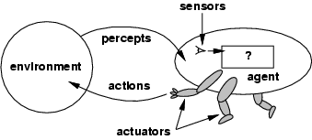
Agents and Environment
The agent function maps from percept histories to actions:
[f: P* 🡪 A]
The agent program runs on the physical architecture to produce f
agent = architecture + program

Slide 62
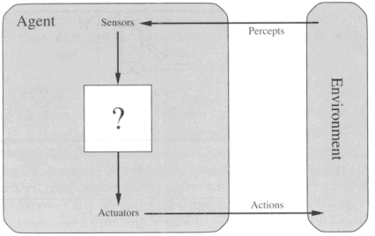
Diagram of an Agent
What AI should fill

Slide 63
Simple Terms
Percept
Agent’s perceptual inputs at any given instant
Percept sequence
Complete history of everything that the agent has ever perceived.

Slide 64
Unit 1 List of Topics
Introduction to AI-AI techniques
Problem solving with AI
AI Models, Data acquisition and learning aspects in AI
Problem solving- Problem solving process, Formulating problems
Problem types and characteristics
Problem space and search
Intelligent agent
Rationality and Rational agent with
performance measures
Flexibility and Intelligent agents
Task environment and its properties
Types of agents
Other aspects of agents
Constraint satisfaction problems(CSP)
Crypto arithmetic puzzles
CSP as a search problem-constrains and representation
CSP-Backtracking, Role of heuristic
CSP-Forward checking and constraint propagation
CSP-Intelligent backtracking

Slide 65
Rationality
Rationality. Rationality is nothing but status of being reasonable, sensible, and having good sense of judgment. Rationality is concerned with expected actions and results depending upon what the agent has perceived. Performing actions with the aim of obtaining useful information is an important part of rationality.

Slide 66
What is Ideal Rational Agent?
An ideal rational agent is the one, which is capable of doing expected actions to maximize its performance measure, on the basis of −
Its percept sequence
Its built-in knowledge base
Rationality of an agent depends on the following −
The performance measures, which determine the degree of success.
Agent’s Percept Sequence till now.
The agent’s prior knowledge about the environment.
The actions that the agent can carry out.
A rational agent always performs right action, where the right action means the action that causes the agent to be most successful in the given percept sequence. The problem the agent solves is characterized by Performance Measure, Environment, Actuators, and Sensors (PEAS).

Slide 67
Rational Agents
Rational Agent: one that does the right thing
Criteria: Performance measure
Performance measures for
Web search engine?
Tic-tac-toe player? Chess player?
How does when performance is measured play a role?
short vs. long term

Slide 68
Rational Agents
Omniscient agent
Knows the actual outcome of its actions
What information would a chess player need to have to be omniscient?
Omniscience is (generally) impossible
A rational agent should do the right thing based on the knowledge it has

Slide 69
Rational Agents
What is rational depends on four things:
Performance measure
Percept sequence: everything agent has seen so far
Knowledge agent has about environment
Actions agent is capable of performing
Ideal Rational Agent
Does whatever action is expected to maximize its performance measure, based on percept sequence and built-in knowledge

Slide 70
Ideal Mapping
Percept sequence is only varying element of rationality
Percept Sequence → Action
In theory, can build a table mapping percept sequence to action
Sample table for chess board
Ideal mapping describes behavior of ideal agents

Slide 71
The Mapping Table
In most cases, mapping is explosively too large to write down explicitly
In some cases, mapping can be defined via a specification
Example: agent to sort a list of numbers
Sample table for such an agent
Lisp code

Slide 72
Autonomy
“Independence”
A system is autonomous if its behavior is determined by its own experience
An alarm that goes off at a prespecified time is not autonomous
An alarm that goes off when smoke is sensed is autonomous
A system without autonomy lacks flexibility

Slide 73
Structure of Intelligent Agents
AI designes the agent program
The program runs on some kind of architecture
To design an agent program, need to understand
Percepts
Actions
Goals
Environment

Slide 74
Some Sample Agents
What are percepts, actions, goals, and environment for:
Chess Player?
Web Search Tool?
Matchmaker?
Musical performer?
Environments can be real (web search tool) or artificial (Turing test)
distinction is about whether it is a simulation for agent or the “real thing”

Slide 75
Agent Programs
Some extra Lisp: Persistence of state (static variables)
Allows a function to keep track of a variable over repeated calls.
Put functions inside a let block
(let ((sum 0)) (defun myfun (x) (setf sum (+ sum x))) (defun report () sum) )

Slide 76
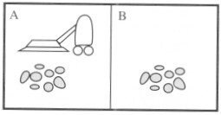
Vacuum-cleaner
Consider a Vacuum cleaner world
Imagine that our intelligent agent is a robot vacuum cleaner. Let's suppose that the world has just two rooms.
The robot can be in either room and there can be dirt in zero, one, or two rooms.

Slide 77
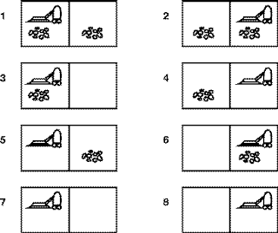
Vacuum-cleaner World

Slide 78
Vacuum-cleaner world
Perception: Clean or Dirty? where it is in?
Goal formulation: intuitively, we want all the dirt cleaned up. Formally, the goal is
{ state 7, state 8 }.
Problem formulation(Actions):
Move Left, Move Right, Suck, NoOp(do nothing)

Slide 79
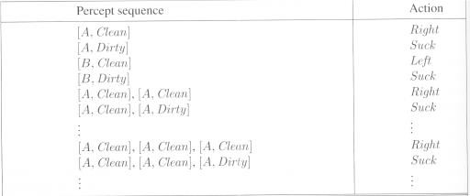
Vacuum-cleaner world
Partial tabulation of a simple agent function for the vacuum-cleaner world

Slide 80
Vacuum-cleaner world
Program implements the agent function tabulated
Function Reflex-Vacuum-Agent([location,status]) return an action
If status = Dirty then return Suck
else if location = A then return Right
else if location = B then return left

Slide 81
Unit 1 List of Topics
Introduction to AI-AI techniques
Problem solving with AI
AI Models, Data acquisition and learning aspects in AI
Problem solving- Problem solving process, Formulating problems
Problem types and characteristics
Problem space and search
Intelligent agent
Rationality and Rational agent with
performance measures
Flexibility and Intelligent agents
Task environment and its properties
Types of agents
Other aspects of agents
Constraint satisfaction problems(CSP)
Crypto arithmetic puzzles
CSP as a search problem-constrains and representation
CSP-Backtracking, Role of heuristic
CSP-Forward checking and constraint propagation
CSP-Intelligent backtracking

Slide 82
Performance Measuring
With any intelligent agent, we want it to find a (good) solution and not spend forever doing it.
The interesting quantities are, therefore,
the search cost--how long the agent takes to come up with the solution to the problem, and
the path cost--how expensive the actions in the solution are.
The total cost of the solution is the sum of the above two quantities.

Slide 83
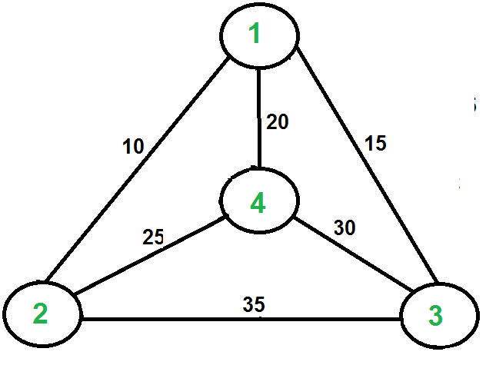
Performance Measures
STATES, OPERATORS, GOAL TEST & PATH COST
TSP - Naive Solution revisited:
Consider city 1 as the starting and ending point.
2) Generate all (n-1)! Permutations of cities.
Calculate cost of every permutation and keep track of minimum cost permutation.
Return the permutation with minimum
cost.
Solution is complete, optimal, time and space complexity = n!

Slide 84
Measuring problem-solving performance
Completeness: Is the algorithm guaranteed to find a solution when there is one?
Optimality: Does the strategy find the optimal solution (i.e., lowest path cost among all solutions)
Time complexity: How long does it take to find a solution?
Space complexity: How much memory is needed to perform the search?

Slide 85
Real-world Problems
Example of rational action performed by any intelligent agent:
Automated Taxi Driver:
Performance Measure: Safe, fast, legal, comfortable trip, maximize profits.
Environment: Roads, other traffic, customers.
Actuators: Steering wheel, accelerator, brake, signal, horn.
Sensors: Cameras, sonar, speedometer, GPS, odometer, engine sensors, keyboard.

Slide 86
Unit 1 List of Topics
Flexibility and Intelligent agents
Task environment and its properties
Types of agents
Other aspects of agents
Constraint satisfaction problems(CSP)
Crypto arithmetic puzzles
CSP as a search problem-constrains and representation
CSP-Backtracking, Role of heuristic
CSP-Forward checking and constraint propagation
CSP-Intelligent backtracking
Introduction to AI-AI techniques
Problem solving with AI
AI Models, Data acquisition and learning aspects in AI
Problem solving- Problem solving process, Formulating problems
Problem types and characteristics
Problem space and search
Intelligent agent
Rationality and Rational agent with performance measures

Slide 87
Flexibility and Intelligent agents
Agents need to be Flexible.
Handle dynamic Scenarios
Flexibility Agent should need to,
1. Responsive – timely respond
2. Pro-Active - goal-directed behavior
3. Social – should interact with other Artificial Agents and humans to complete problem- solving.

Slide 88
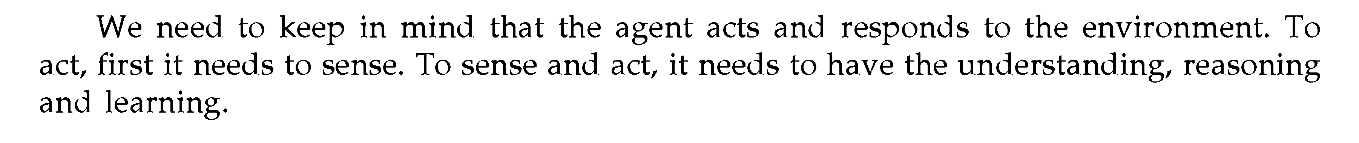
Other Properties of Intelligent Agent
Mobility – Should be mobile to accumulate knowledge (decision making)
Veracity – truthful and should not hide information.
Benevolence – Should avoid conflict and should do what is told
Rationality – should act to maximize the expected performance
Learning – Performance is increased with learning, and you should have learning ability.
Note :

Slide 89
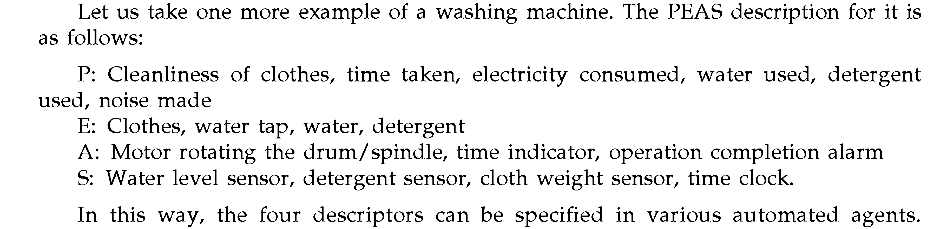
Task environment and its properties

Slide 90
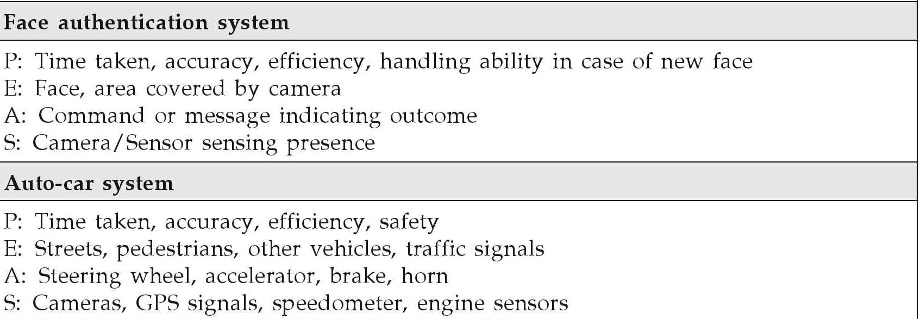
EXAMPLE: Agent Types and their PEAS Description
PEAS Description is the core part of designing an agent.

Slide 91
Agent can be
Single and Multi-Agent
- Chess
- Crossword
- Football

Slide 92
Types of Agent
Table Driven agents
Simple Reflex agents
Model – based reflex agents
Goal–based agents
Utility–based agents

Slide 93
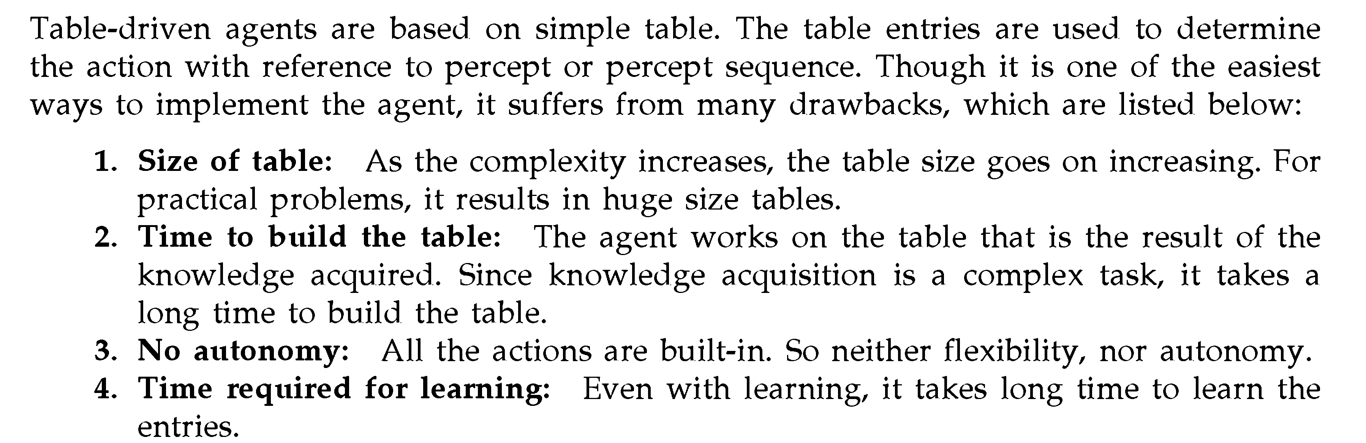
Table Driven agents

Slide 94
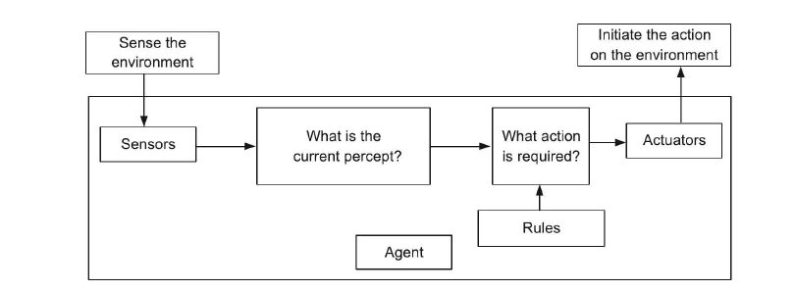
Simple Reflex agents
Its one of the simple rule based agent that takes into account only the current percept.
Defn:
Action decided by condition

Slide 95
Model – based Reflex agents
In Real life, problems face issues with a partially observable environment without keeping track of previous states.
This agent has maintained some of the unobserved aspects of the current state. (reflects)
This model need to know
How has the world evolved independent of agents?
How does the agent’s action affect the world?
By incorporating these two things to determine the model.

Slide 96
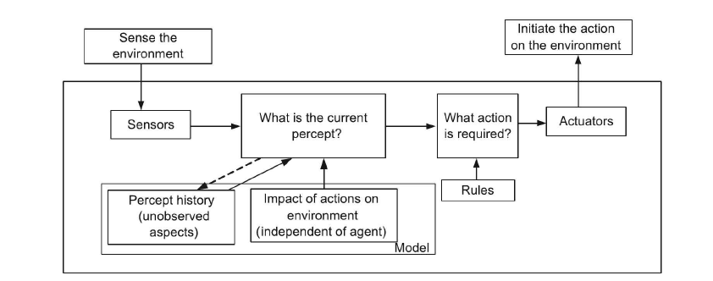
Model – based Reflex Agents

Slide 97
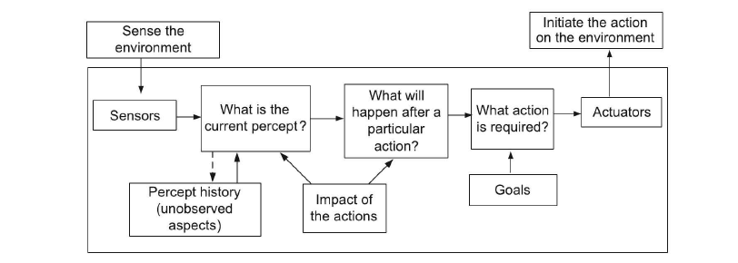
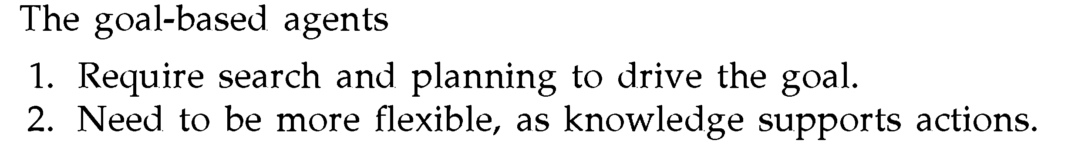
Goal–based agents
Example
Car driving (Landmark)
- Building knowledge with reference to goal.
- More amount of time is required for the reasoning process as it is goal-oriented.

Slide 98
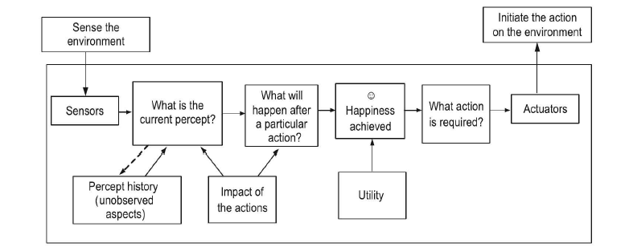
Utility–based agents
Just a goal is not sufficient to describe what we want to achieve out of the agent.
Utility function is most often a real number that maps to the degree of happiness.

Slide 99
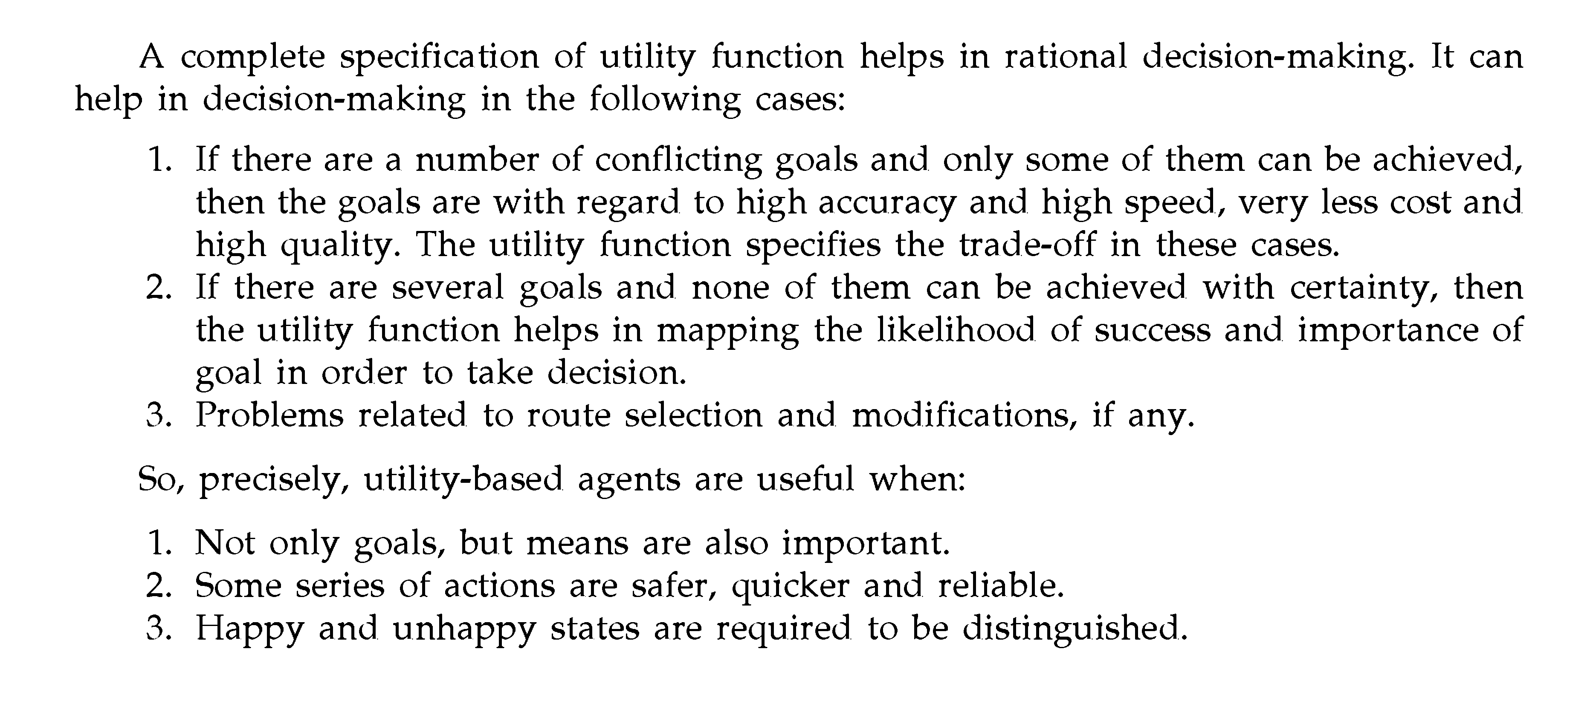
Utility–based agents

Slide 100
Learning Agents
Important Element of Learning Agents
1. Performance Element
2. Learning Element
Performance Element:
Responsible for making improvements
Learning Element
Responsible for the selection of external actions.

Slide 101
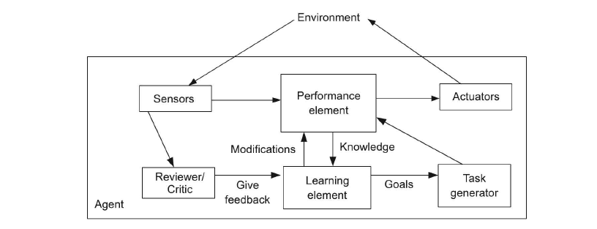
Learning Agent

Slide 102
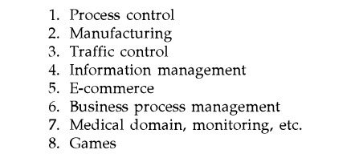
Other Aspects of Intelligent Agents
- Dynamic Learning Capability
Application domains of Intelligent agents

Slide 103

Draw backs of Intelligent Agents
No overall system controllers
No global perspective
Bottlenecks in agent development

Slide 104
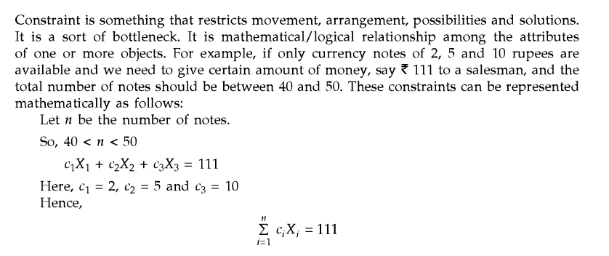
Constraint Satisfaction Problem(CSP)
Constraint – Condition

Slide 105
Types of Constraint
Unary Constraint
Binary Constraint
Higher order Constraint

Slide 106
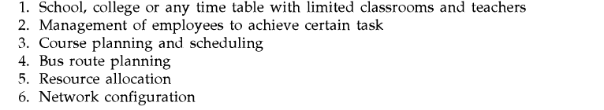
Example for Constraint Satisfaction and Constraint Programming

Slide 107
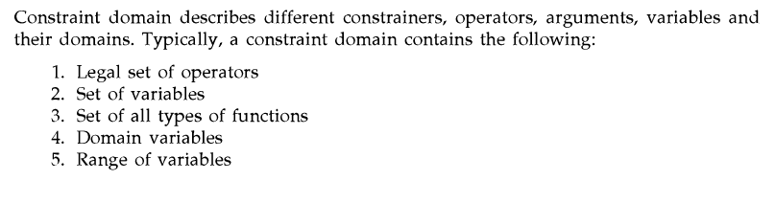
Constraint Domain

Slide 108
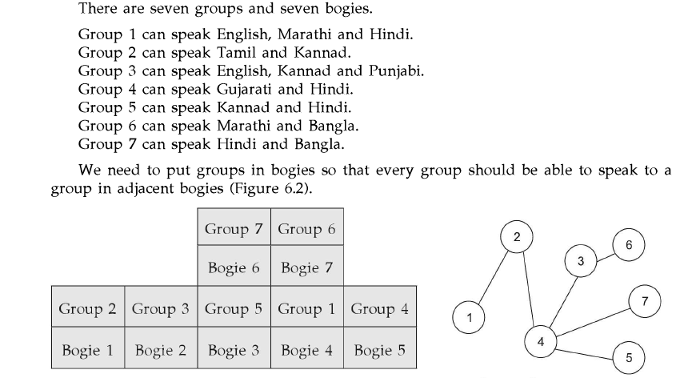
Group Assignment Problem

Slide 109
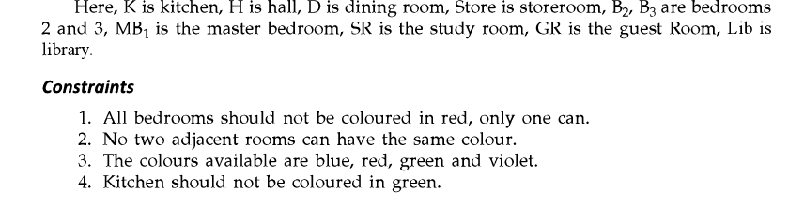
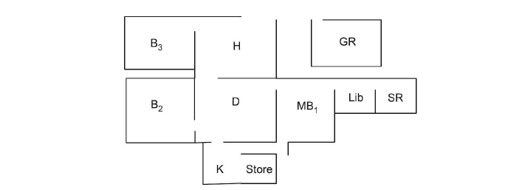
CSP As a SEARCH PROBLEM

Slide 110
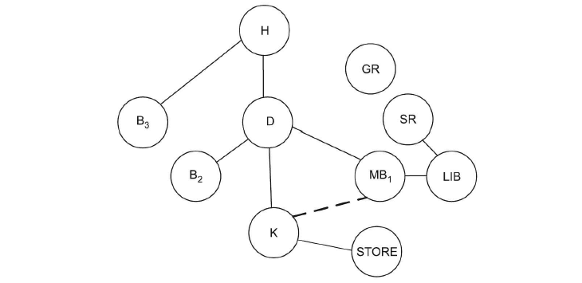
Representation as a Search Problem

Slide 111
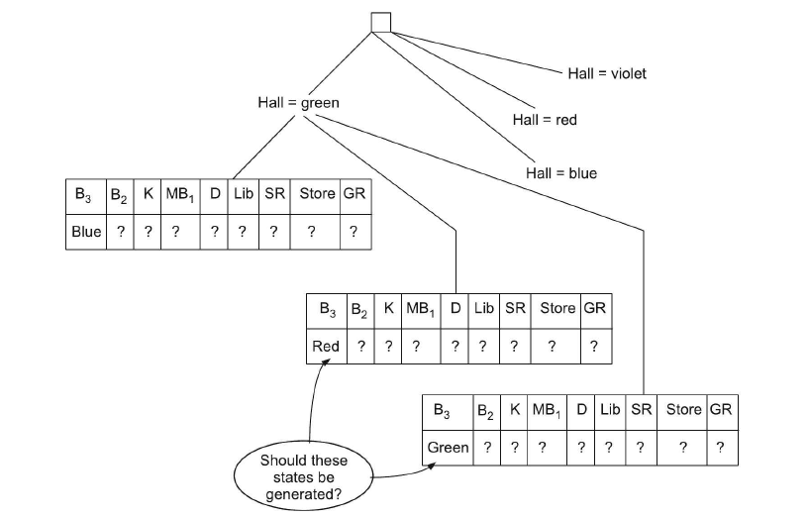
Search Tree Generation

Slide 112
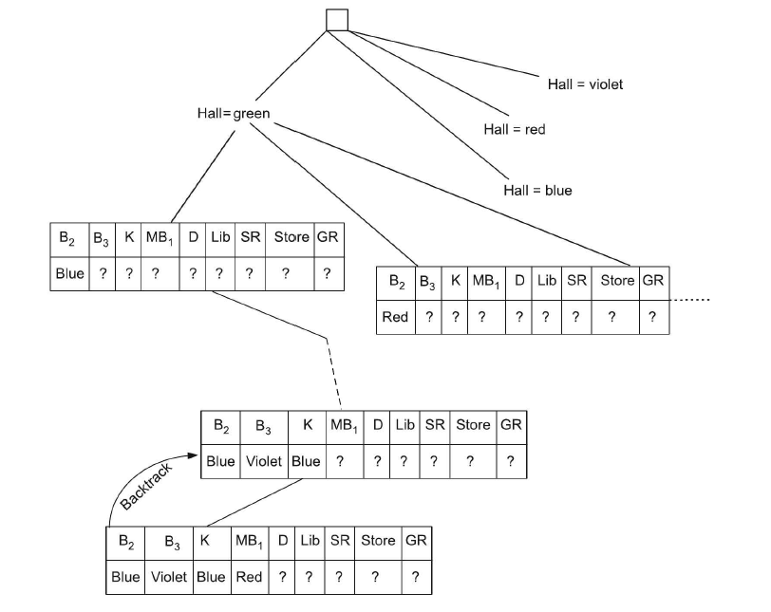
Backtracking Search for CSP

Slide 113
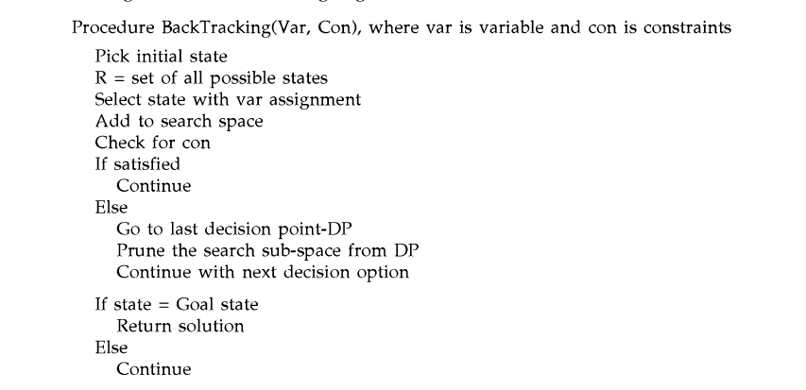
Procedure Backtracking Algorithm

Slide 114
Role of Heuristic
- Deciding the initial state as well as guiding the selection of subsequent states.
- Selection should be a minimum number of possible values that leads to a simplified search * Referred as Minimum Remaining Values heuristic( MRV)/ Most Constraint Variable.
*Detect failure at an early stage.

Slide 115
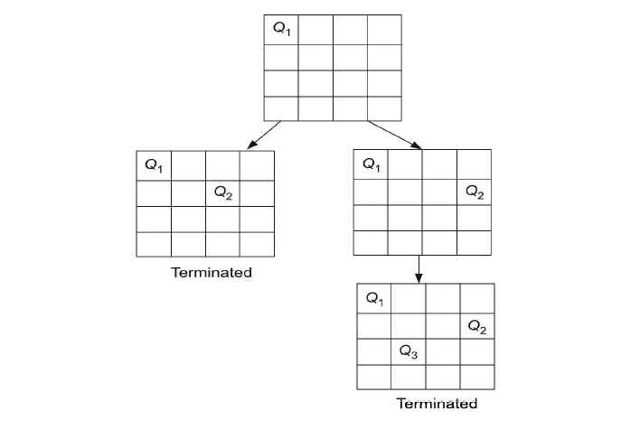
Forward Checking

Slide 116
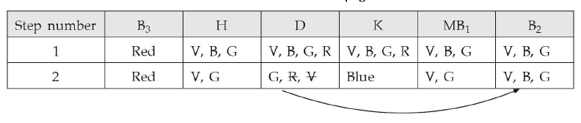
Constraint Propagation
Using the constraints to reduce the number of legal values for a variable, which in turn can reduce the legal values for another variable, and so on.

Slide 117
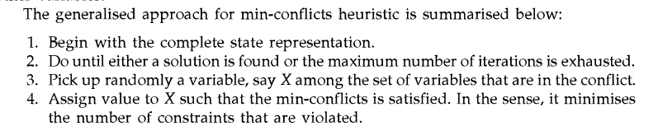
Local Search for Constraint Satisfaction Problem

Slide 118
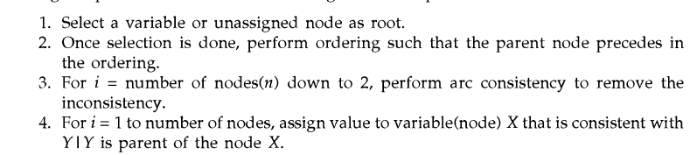

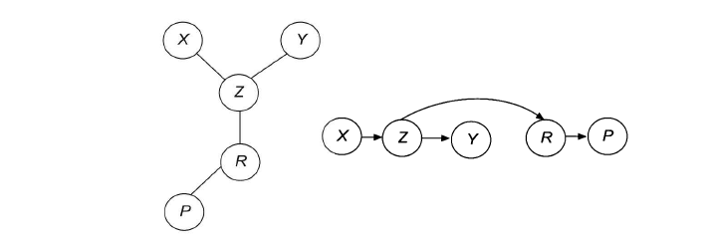
Formulating Problem Structure

Slide 119
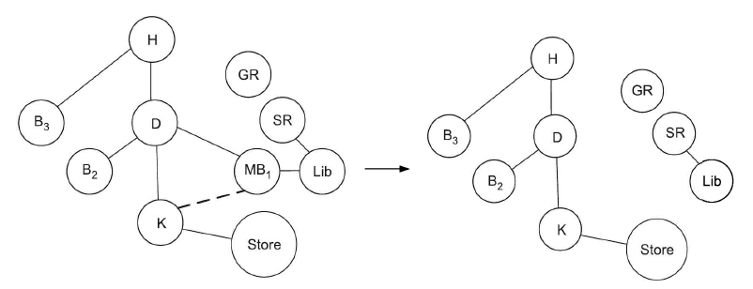
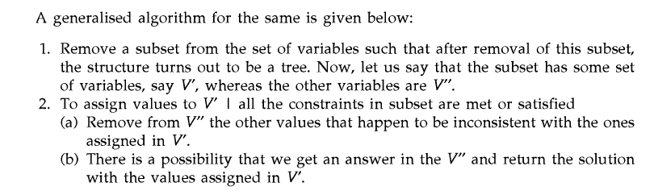
Tree Structured CSP example

